Slide 1


Slide 2
Chapter 10
Strategic Capacity Planning

Slide 3
OBJECTIVES
Strategic Capacity Planning Defined
Capacity Utilization & Best Operating Level
Economies & Diseconomies of Scale
The Experience Curve
Capacity Focus, Flexibility & Planning
Determining Capacity Requirements
Decision Trees
Capacity Utilization & Service Quality
Notes:
2

Slide 4
Strategic Capacity Planning
Defined
Capacity can be defined as the ability to hold, receive, store, or accommodate
Strategic capacity planning is an approach for determining the overall capacity level of capital intensive resources, including facilities, equipment, and overall labor force size
Notes:
3

Slide 5
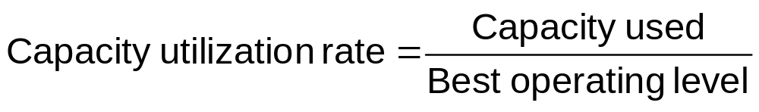
Capacity Utilization
Where
Capacity used
  rate of output actually achieved
Best operating level
  capacity for which the process was designed
Notes:
5

Slide 6
Best Operating Level
Example: Engineers design engines and assembly lines to operate at an ideal or “best operating level” to maximize output and minimize ware
Average
unit cost
of output
Underutilization
Overutilization
Best Operating
Level
Volume

Slide 7
Example of Capacity Utilization
During one week of production, a plant produced 83 units of a product. Its historic highest or best utilization recorded was 120 units per week. What is this plant’s capacity utilization rate?
Answer:
Capacity utilization rate = Capacity used .
  Best operating level
  = 83/120
  =0.69 or 69%
Notes:
6

Slide 8
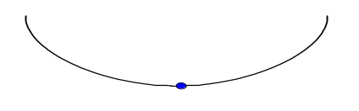
Economies & Diseconomies of Scale
Economies of Scale and the Experience Curve working
100-unit
plant
Average
unit cost
of output
200-unit
plant
400-unit
plant
300-unit
plant
Diseconomies of Scale start working
Volume

Slide 9
The Experience
Curve
As plants produce more products, they gain experience in the best production methods and reduce their costs per unit
Yesterday
Cost or
price
per unit
Today
Tomorrow
Total accumulated production of units

Slide 10
Capacity Focus
The concept of the focused factory holds that production facilities work best when they focus on a fairly limited set of production objectives
Plants Within Plants (PWP) (from Skinner)
  Extend focus concept to operating level
Notes:
10

Slide 11
Capacity Flexibility
Flexible plants
Flexible processes
Flexible workers
Notes:
11

Slide 12
Capacity Planning: Balance
Unbalanced stages of production
Units
per
month
Stage 1
Stage 2
Stage 3
6,000
7,000
5,000
Maintaining System Balance: Output of one stage is the exact input requirements for the next stage
Balanced stages of production
Units
per
month
Stage 1
Stage 2
Stage 3
6,000
6,000
6,000
Notes:
12

Slide 13
Capacity Planning
Frequency of Capacity Additions
External Sources of Capacity
Notes:
13

Slide 14
Determining Capacity Requirements
1. Forecast sales within each individual product line
2. Calculate equipment and labor requirements to meet the forecasts
3. Project equipment and labor availability over the planning horizon
Notes:
14

Slide 15
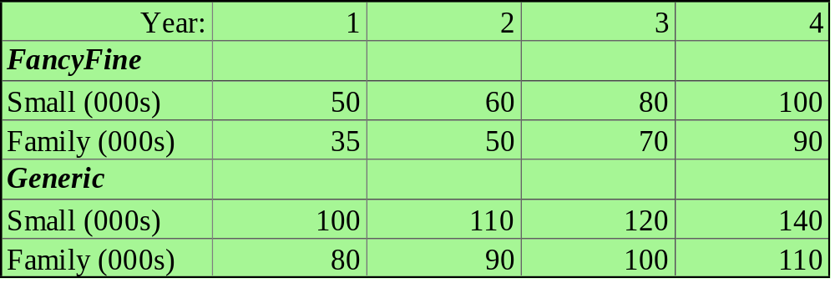
Example of Capacity Requirements
A manufacturer produces two lines of mustard, FancyFine and Generic line. Each is sold in small and family-size plastic bottles.
The following table shows forecast demand for the next four years.
Notes:
15

Slide 16
Example of Capacity Requirements (Continued): Product from a Capacity Viewpoint
Question: Are we really producing two different types of mustards from the standpoint of capacity requirements?
Answer: No, it’s the same product just packaged differently.
Notes:
16

Slide 17
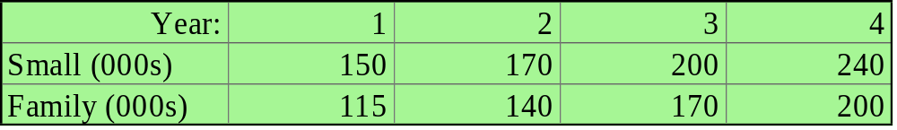
Example of Capacity Requirements (Continued) : Equipment and Labor Requirements
Three 100,000 units-per-year machines are available for small-bottle production. Two operators required per machine.
Two 120,000 units-per-year machines are available for family-sized-bottle production. Three operators required per machine.
Notes:
17

Slide 18
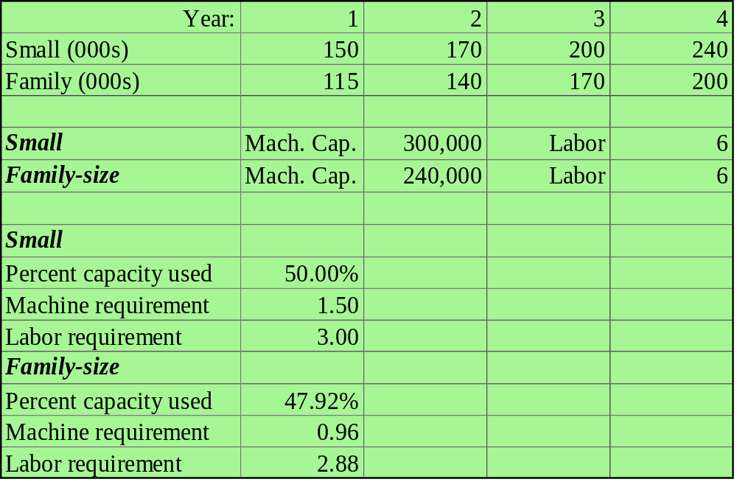
Question: What are the Year 1 values for capacity, machine, and labor?
150,000/300,000=50%
At 1 machine for 100,000, it takes 1.5 machines for 150,000
At 2 operators for 100,000, it takes 3 operators for 150,000
The McGraw-Hill Companies, Inc., 2004
Notes:
18

Slide 19
Question: What are the values for columns 2, 3 and 4 in the table below?
56.67%
1.70
3.40
66.67%
2.00
4.00
80.00%
2.40
4.80
58.33%
1.17
3.50
70.83%
1.42
4.25
83.33%
1.67
5.00
The McGraw-Hill Companies, Inc., 2004
Notes:
18

Slide 20
Example of a Decision Tree Problem
A glass factory specializing in crystal is experiencing a substantial backlog, and the firm's management is considering three courses of action:
A) Arrange for subcontracting
B) Construct new facilities
C) Do nothing (no change)
The correct choice depends largely upon demand, which may be low, medium, or high. By consensus, management estimates the respective demand probabilities as 0.1, 0.5, and 0.4.
Notes:
20

Slide 21
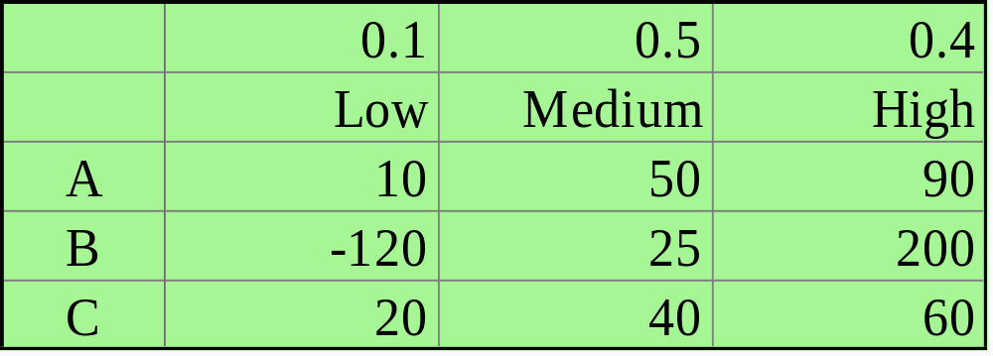
Example of a Decision Tree Problem (Continued): The Payoff Table
The management also estimates the profits when choosing from the three alternatives (A, B, and C) under the differing probable levels of demand. These profits, in thousands of dollars are presented in the table below:
Notes:
21

Slide 22
Example of a Decision Tree Problem (Continued): Step 1. We start by drawing the three decisions
A
B
C
Notes:
22

Slide 23
Example of Decision Tree Problem (Continued): Step 2. Add our possible states of nature, probabilities, and payoffs
High demand (0.4)
$90k
Medium demand (0.5)
$50k
Low demand (0.1)
$10k
A
High demand (0.4)
$200k
B
Medium demand (0.5)
$25k
Low demand (0.1)
-$120k
C
High demand (0.4)
$60k
Medium demand (0.5)
$40k
Low demand (0.1)
$20k
Notes:
23

Slide 24

Example of Decision Tree Problem (Continued): Step 3. Determine the expected value of each decision
High demand (0.4)
$90k
Medium demand (0.5)
$50k
$62k
$10k
Low demand (0.1)
A
EV_{A}=0.4(90)+0.5(50)+0.1(10)=$62k
Notes:
24

Slide 25
Example of Decision Tree Problem (Continued): Step 4. Make decision
High demand (0.4)
$90k
Medium demand (0.5)
$50k
$62k
$10k
Low demand (0.1)
A
High demand (0.4)
$200k
$80.5k
B
Medium demand (0.5)
$25k
Low demand (0.1)
-$120k
C
High demand (0.4)
$60k
$46k
Medium demand (0.5)
$40k
Low demand (0.1)
$20k
Alternative B generates the greatest expected profit, so our choice is B or to construct a new facility
Notes:
25

Slide 26
Planning Service Capacity vs. Manufacturing Capacity
Time: Goods can not be stored for later use and capacity must be available to provide a service when it is needed
Location: Service goods must be at the customer demand point and capacity must be located near the customer
Volatility of Demand: Much greater than in manufacturing
Notes:
26

Slide 27
Capacity Utilization &
Service Quality
Best operating point is near 70% of capacity
From 70% to 100% of service capacity, what do you think happens to service quality?
Notes:
27

Slide 28
End of Chapter 10

